Slide 1
Smart Transport
An application for tracking CO2 emissons and energy consumption w.r.t transport
Team 7
Prashanth.B, Swe.G and Jonathan.J
Smart Energy – Fall 2017
ETH Zurich

Slide 2
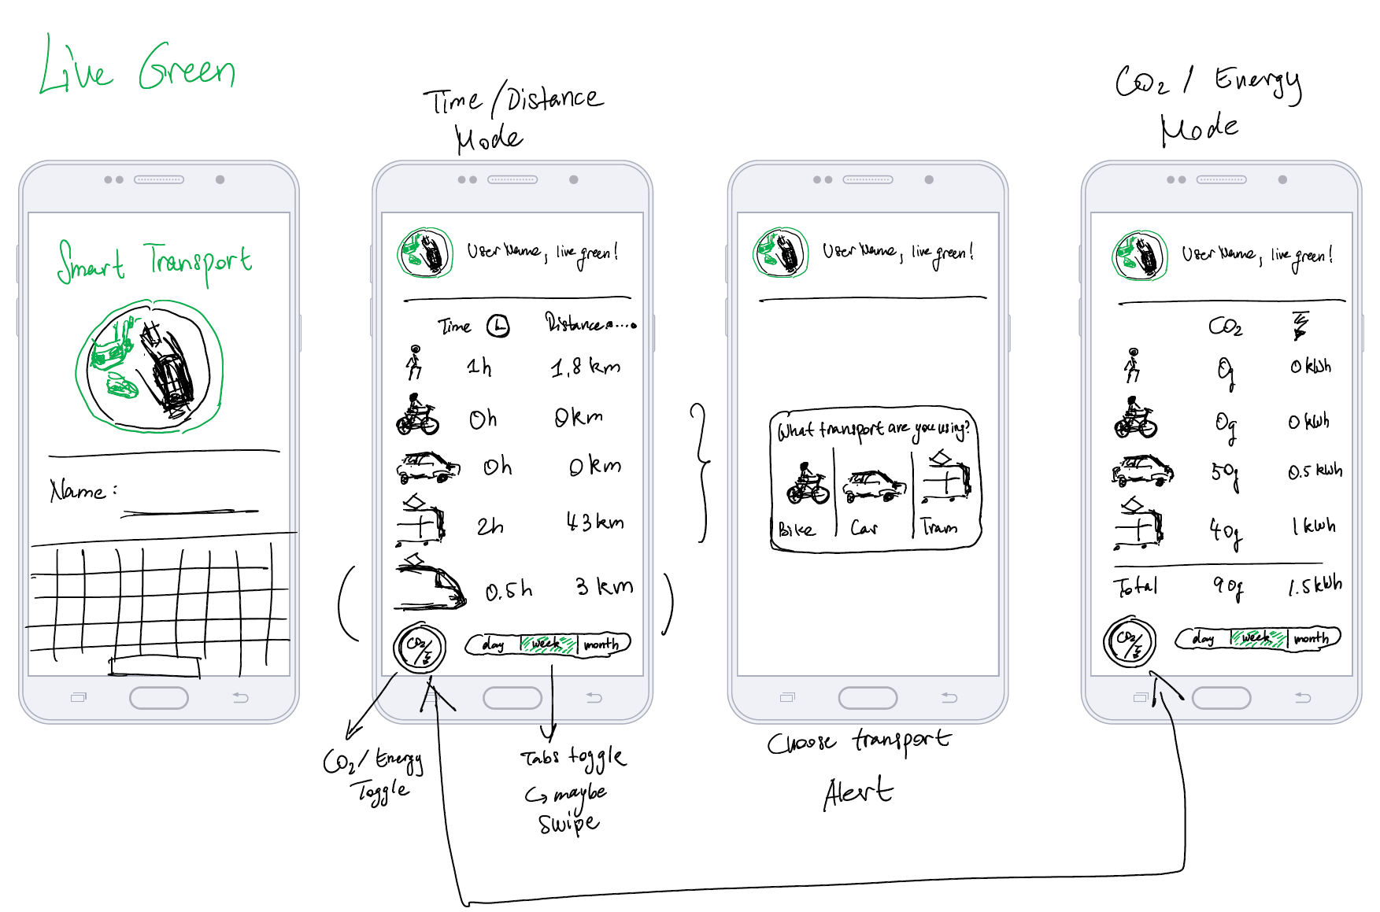
Mock-up

Slide 3
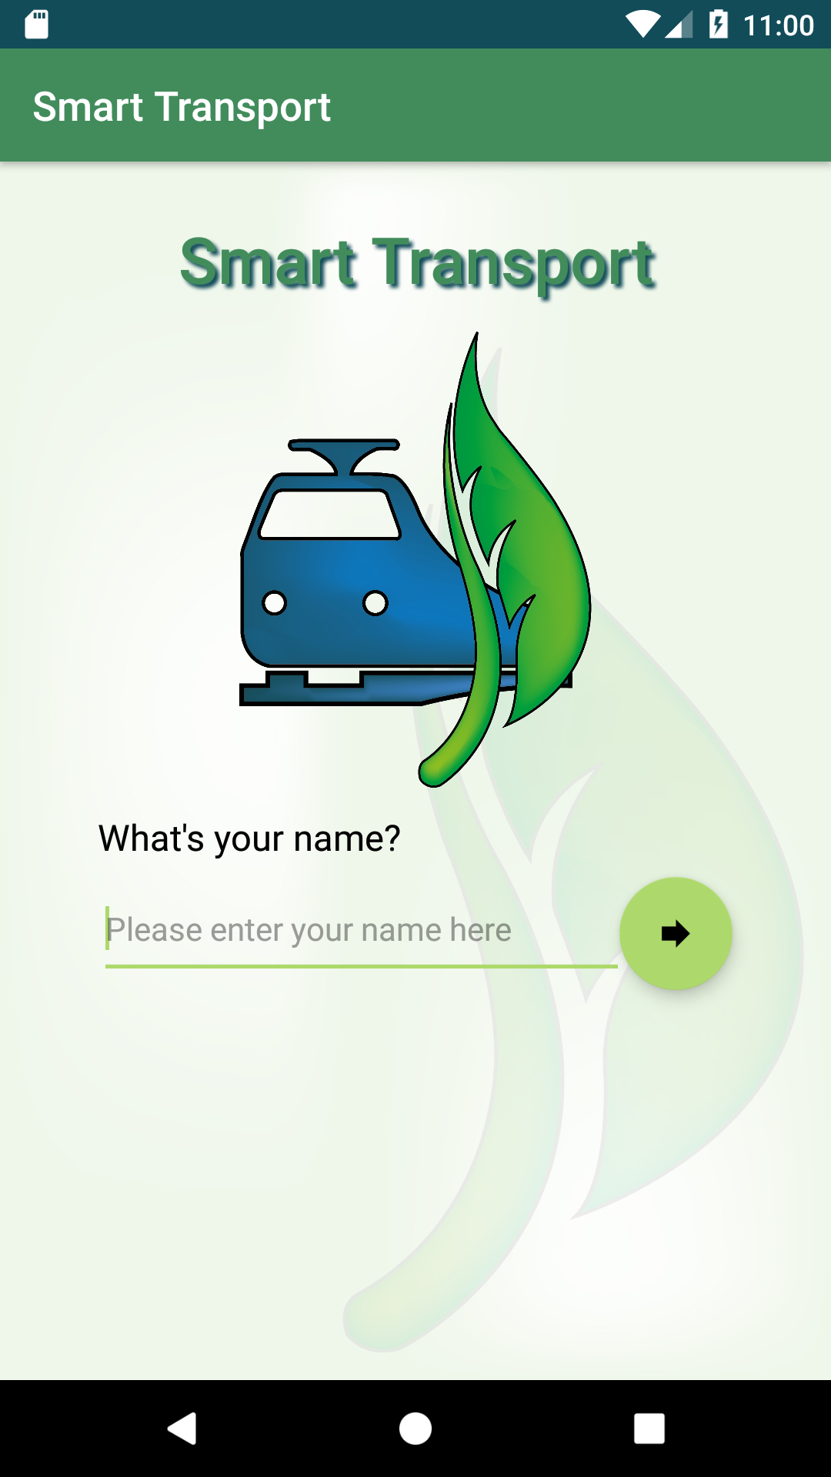
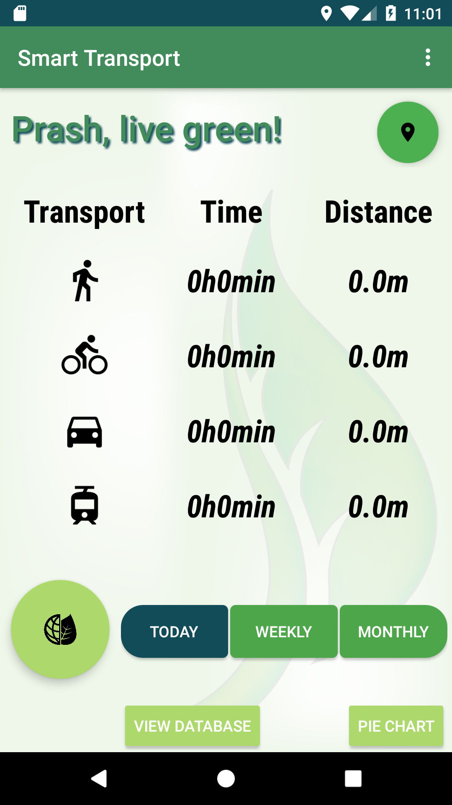
Graphical User Interface

Slide 4
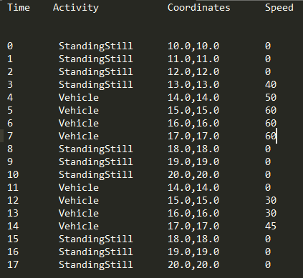
Automatically Infer Means of Transport
Detected Activity
Walking/Running/Standing Still
Bicycle
Vehicle
Tram
If(patternObserved && currentSpeedOverlap)
else
Car

Slide 5
Information for Calculating CO2 Emissions and Primary Energy Usage

Slide 6
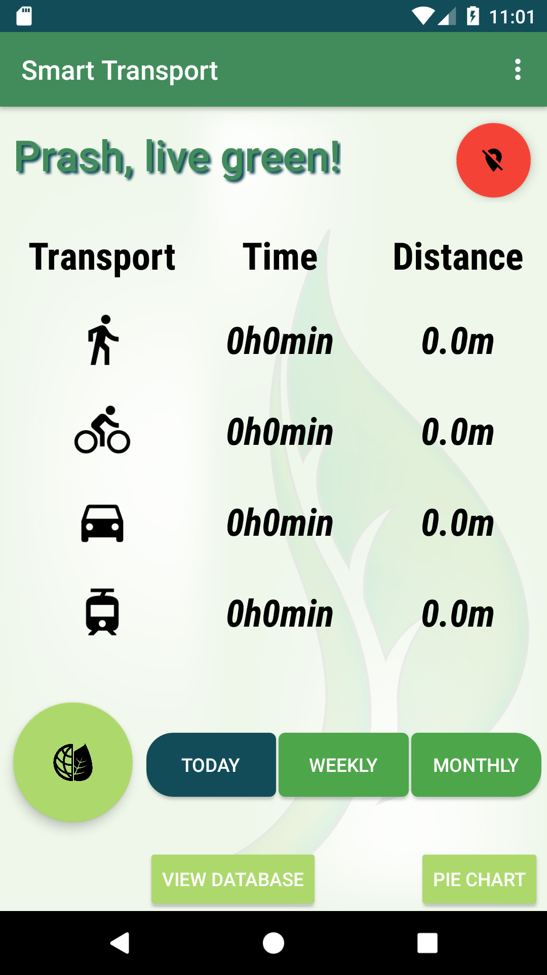
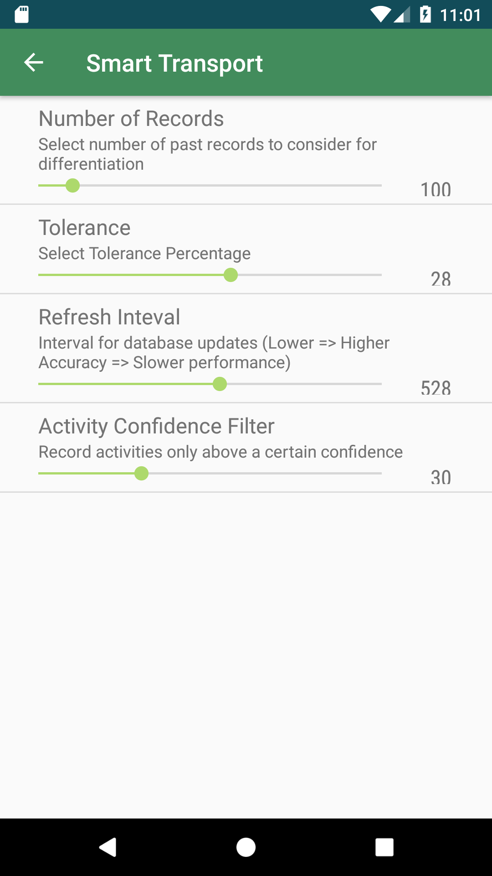
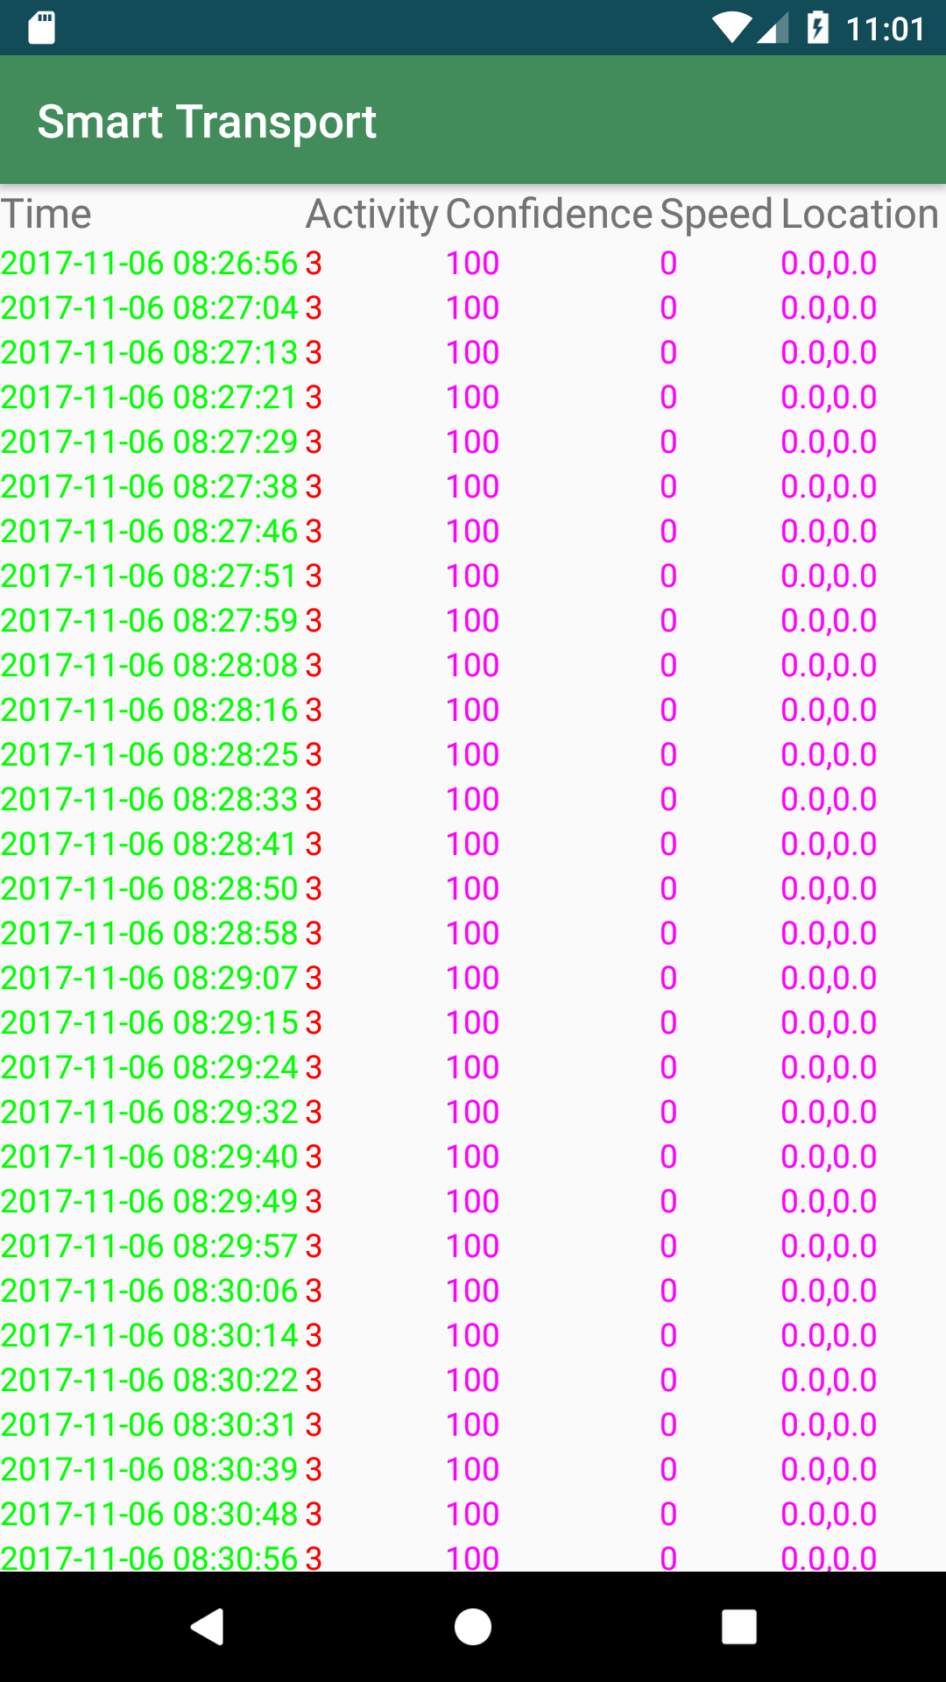
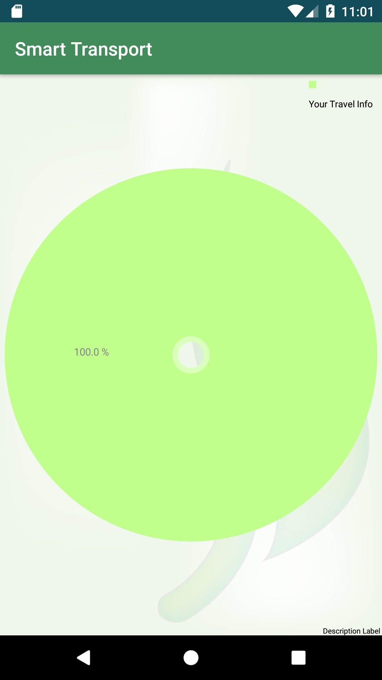
Architecture
UI Thread
Background Thread

Slide 7
Summary
+ Created an application that monitors day to day activities efficiently
+ Tackled the problem of car/tram differentiation
+ Flexible UI to Enable/Disable logging. Settings screen to fine tune parameters.
+ Appealing GUI with a PieChart!
Frequent logging leads to performance loss
Database queries pose a significant overhead when there are a large number of records (>1000)
The code will be made open source for further development. Lots of potential for more attractive features!

